Slide 1

Why Test Automation Projects Fail
(and what to do about it)
Bj Rollison
Test Architect
Microsoft, Inc.
http://blogs.msdn.com/imtesty
http://www.testingmentor.com
Copyright © 2007

Slide 2
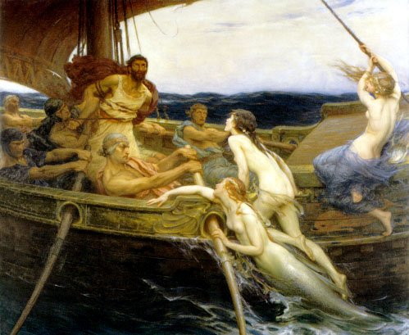
Why Test Automation Projects Fail
Strategic planning
Tactical implementation
Copyright © 2007 – Bj Rollison

Slide 3
Why Test Automation Projects Fail
Strategy – 100% automation
Copyright © 2007 – Bj Rollison

Slide 4
Why Test Automation Projects Fail
Strategy – Reduce development time
Copyright © 2006 – Bj Rollison

Slide 5
Why Test Automation Projects Fail
Strategy – Reduce costs / people
Copyright © 2007 – Bj Rollison

Slide 6
Why Test Automation Projects Fail
Strategy – Defect detection
Copyright © 2007 – Bj Rollison

Slide 7
Why Test Automation Projects Fail
Strategy – S.M.A.R.T goals
Copyright © 2007 – Bj Rollison

Slide 8
Why Test Automation Projects Fail
Tactical – Tools (language, framework, harness)
Copyright © 2007 – Bj Rollison

Slide 9
Why Test Automation Projects Fail
Tactical – Training
Copyright © 2007 – Bj Rollison

Slide 10
Why Test Automation Projects Fail
Tactical – Standards
Copyright © 2007 – Bj Rollison

Slide 11
Why Test Automation Projects Fail
Tactical – Source control
Copyright © 2007 – Bj Rollison

Slide 12
Why Test Automation Projects Fail
Tactical – Part-time automation
Copyright © 2007 – Bj Rollison

Slide 13
Why Test Automation Projects Fail
Tactical – Deciding what to test
Copyright © 2007 – Bj Rollison

Slide 14
Why Test Automation Projects Fail
Tactical – Code quality
Copyright © 2007 – Bj Rollison

Slide 15
References
Just enough software test automation – Daniel Mosley & Bruce Posey
Automate your testing – M.M. Siteur
Software test automation – Mark Fewster & Dorothy Graham
A way of Improving Test Automation Cost-Effectiveness - Jorge Corrêa de Oliveira, Cidinha Costa Gouveia, Rômulo Quidute Fiho
Standards for Test Automation – Brian Tervo
When should a test be automated – Brian Marick
Copyright © 2007 – Bj Rollison

